Slide 1

Introduction to R
Barney Sanderson
November 24

Slide 2
Session 2 - Objectives
Understand how packages can extend the capabilities of R
Gain an introduction to some more complex data types such as strings and dates
Understand how data might be collected into a tidy and rectangular form
Learn how R handles rectangular data and how it can be manipulated

Slide 3
Session Format
Working install of RStudio needed to follow along
Live code demos!
Swap between PowerPoint and RStudio
Monospaced font indicates R code
print("R code")

Slide 4
Session Setup
Locate the RStudio project folder created last week
Save a copy of session_2.R into the R folder

Slide 5


Packages
Packages contain useful R code written by other people

Slide 6
Packages
Packages provide extra functionality to that already included in ‘base R’
For example:
Data structure manipulation
Date and time functionality
Survival analysis
Bayesian statistics
Plotting survival curves
Functionality is provided through new functions

Slide 7
Packages
R has built in data sets in base R
data()
iris
Packages can provide data sets:
As examples to demonstrate the functionality of a package
As the primary reason for the package

Slide 8
Packages
Installing packages
> install.packages("lubridate")
Load packages into your R environment
> library(lubridate)

Slide 9
Packages
If a package is installed, functions from that package can be used without library() call, via :: operator
> lubridate::ymd("2024-12-25")
package and function names separated by double colon ::
name::function

Slide 10

Tidyverse
This course uses a set of packages named the tidyverse
Coherent set of tools for data manipulation and plotting
> install.packages("tidyverse")

Slide 11
Tidyverse
Improve readability for non-programmers
dplyr and tidyr packages are invaluable for data manipulation
ggplot2 package is the plotting library

Slide 12
Tidyverse
> library(tidyverse)
── Attaching core tidyverse packages ─────────────────
✔ dplyr 1.1.4 ✔ readr 2.1.5
✔ forcats 1.0.0 ✔ stringr 1.5.1
✔ ggplot2 3.5.1 ✔ tibble 3.2.1
✔ purrr 1.0.2 ✔ tidyr 1.3.1

Slide 13

Tidyverse
https://www.tidyverse.org/
R for Data Science

Slide 14
Packages and tidyverse
Demo

Slide 15
Data types
Vector of values c(1, 2, 3, 4)
The values contained in a vector, are all the same data type or class
numeric
Integers (or whole numbers ): 1, 2, 3, 4,
Floating point numbers (or floats): 1.2, 3.1415, 1.6x10⁶ = 1,600,000
logical (sometimes referred to as Boolean)
TRUE FALSE

Slide 16
Strings
character type
Characters, text, strings
some_letters <- c("a", "b", "c")
patient_names <- c("Tom", "Barney", "Luigi")
Define a string or character type by delimiting with double quote marks "
Can use single quotes ‘Barney’, but good practice to use double quotes and be consistent

Slide 17

Strings
Strings and character data is very common
stringr package
Common tasks are available as functions
https://stringr.tidyverse.org/
stringr cheatsheet
https://r4ds.had.co.nz/strings.html

Slide 18
Strings - examples
Changing or mutating strings
To upper case
stringr::str_to_upper(string)
Chop out a substring
stringr::str_sub(string, start, end)
Pattern matching
stringr::detect(string, pattern)
Regular expressions

Slide 19
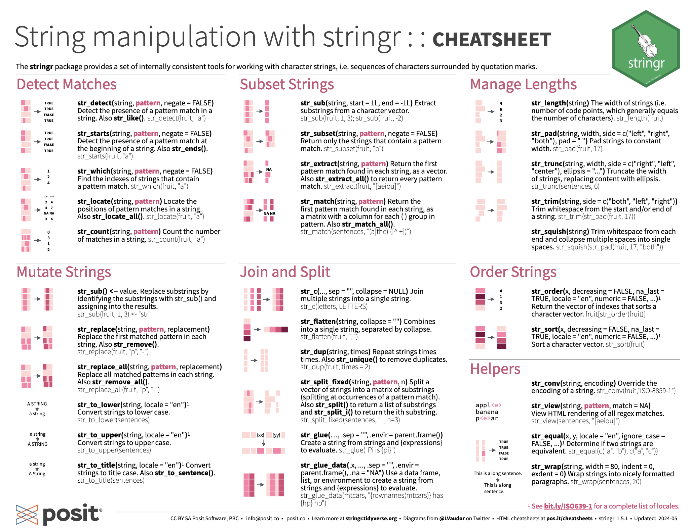

Slide 20
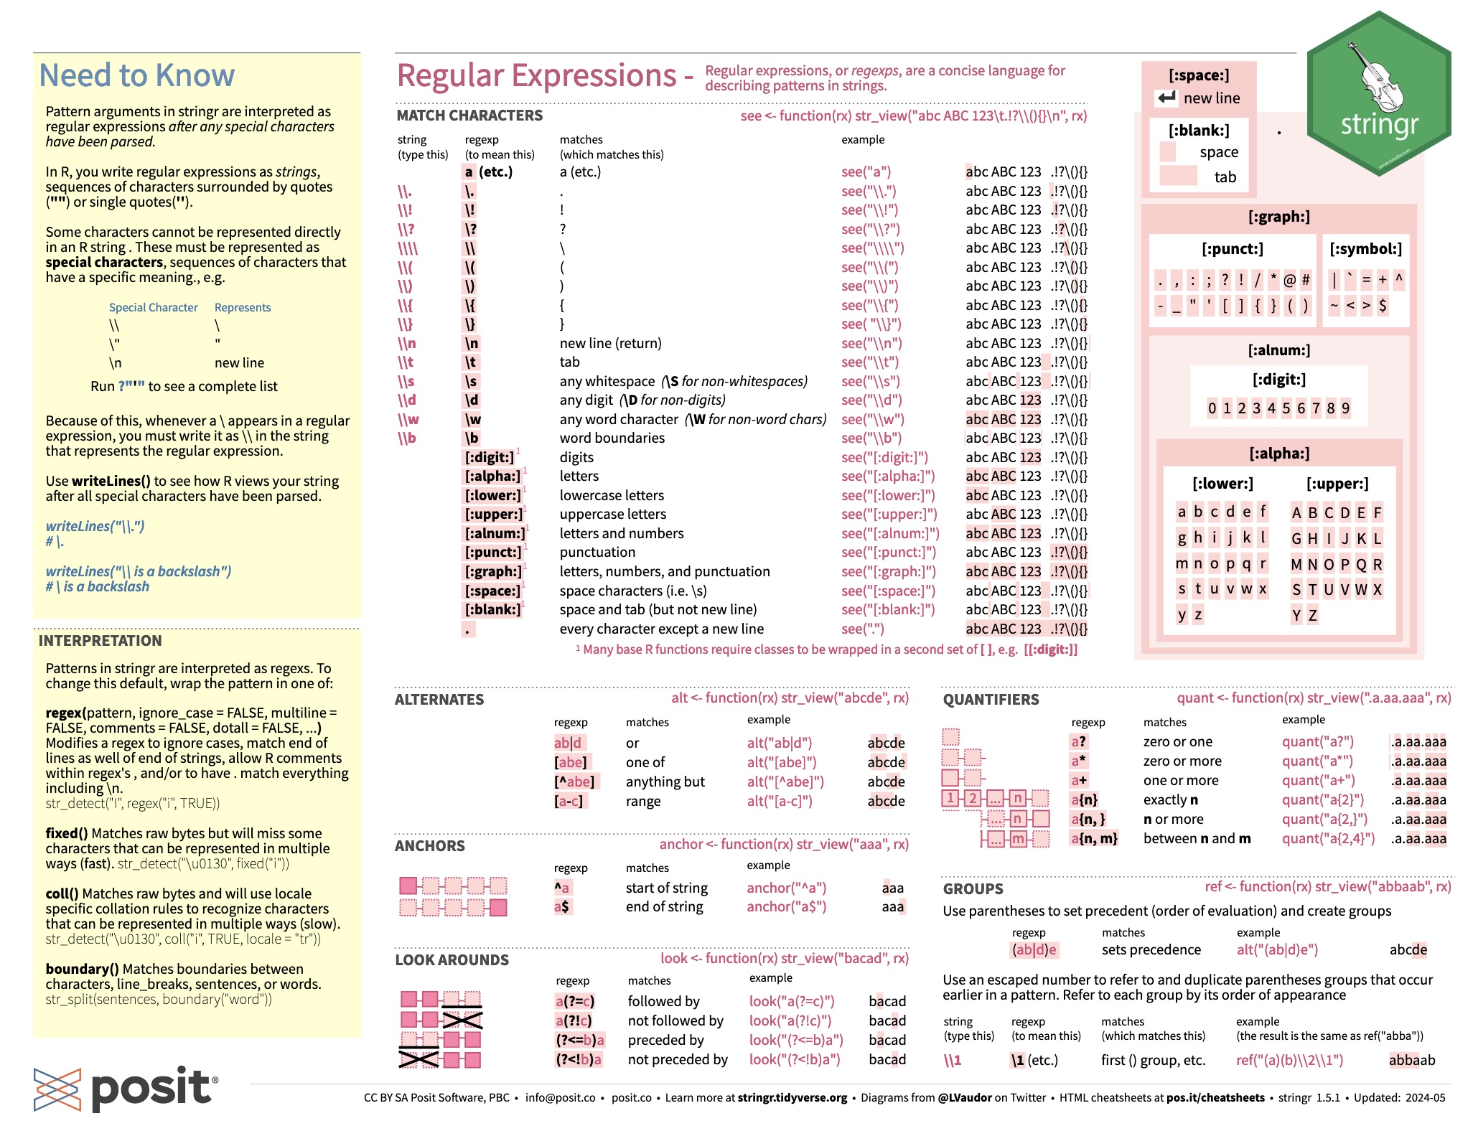

Slide 21
Data types and strings
Demo

Slide 22

Dates and Times
Date type
represented internally by an integer
Number of days since 1970-01-01
as.Date("2024-12-24")
POSIXct type (Date and Time)
Number of seconds since 1970-01-01

Slide 23

Dates and Times
Dates and times are hard
How many days in a year?
How many seconds in an hour?
11/11/2024
11/13/2024 😱
Time zones
https://lubridate.tidyverse.org/
lubridate cheat sheet
https://r4ds.had.co.nz/dates-and-times.html

Slide 24
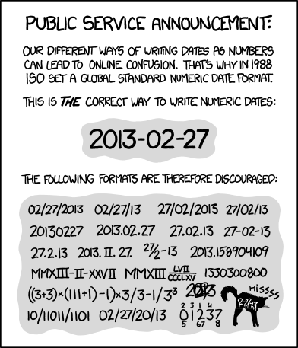
ISO_8601
https://xkcd.com/1179/

Slide 25

Dates and Times
Do not trust Excel with your dates and times!

Slide 26
Dates and Times
Date and Date-time data often available as strings
Creation or parsing of date strings
lubridate::ymd(" 2024/12/25 ")
lubridate::ymd_hms(" 2024/11/15 10:30:05 ")
Often wish to get specific Date-time component
xmas <- ymd(" 2024/12/25 ")
year(xmas) # 2024
month(xmas) # 12

Slide 27
Timespans
Difference in between two date(times)
ymd("2024/12/31") - ymd("2024/12/25")
Time difference of 6 days
difftime object
Periods
ymd(" 2024/12/31 ") + days(6)
ymd(" 2024/12/31 ") + months(1)

Slide 28
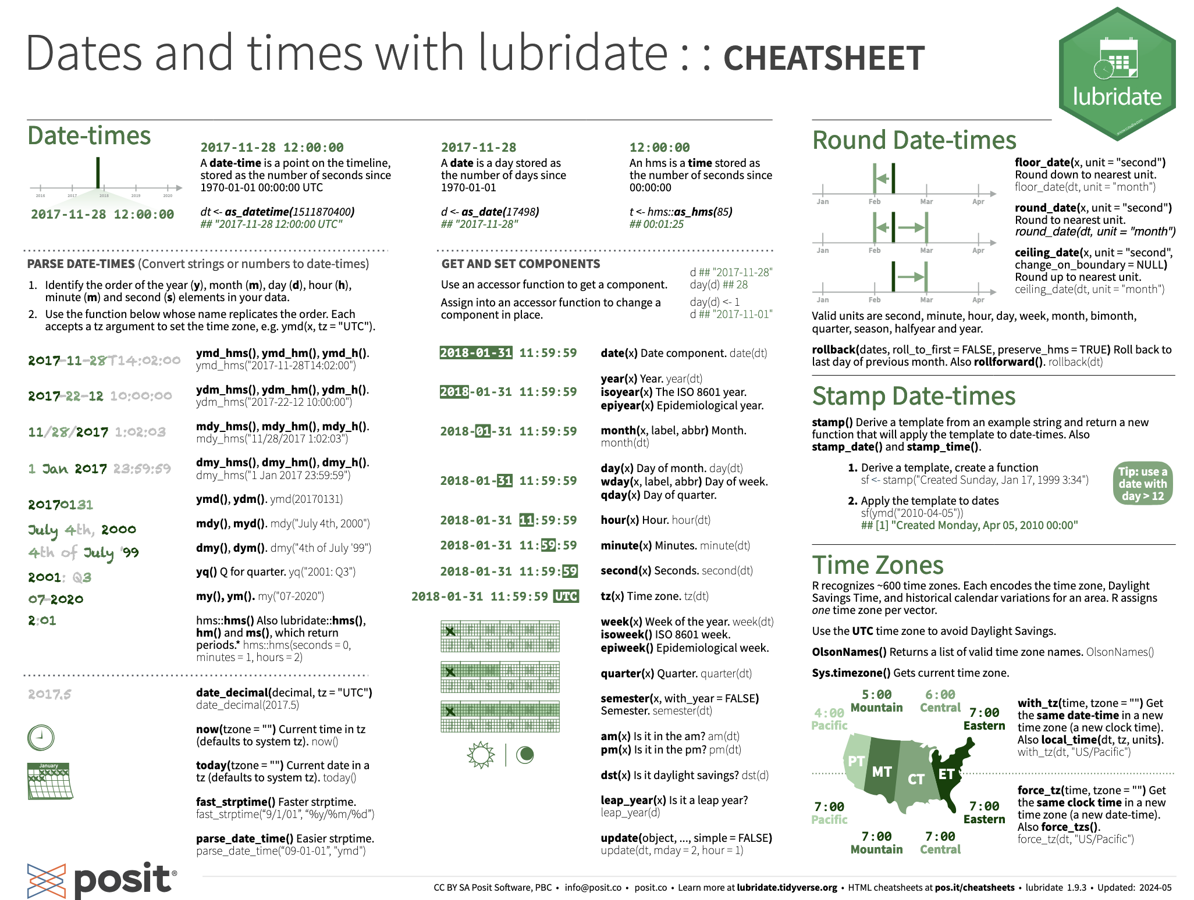

Slide 29
Dates and Times
Demo

Slide 30
Factors
Factors are categorical data
Can be ordered: Mild, Moderate, Severe
Can be unordered: Red, Blue, Green
Common to use strings to represent different categories or factors
https://forcats.tidyverse.org/
https://r4ds.had.co.nz/factors.html

Slide 31
Factors
Specify ‘levels’ of categorical data
e.g. Mild, Moderate, Severe
ards_levels <- c("Mild", "Moderate", "Severe")
factor(ards_data, levels = ards_levels)

Slide 32

Factors
Factors are categorical data
Can be ordered: Mild, Moderate, Severe
Can be unordered: Red, Blue, Green
Common to use strings to represent different categories or factors
https://forcats.tidyverse.org/
https://r4ds.had.co.nz/factors.html

Slide 33
Convert data types
Often need to convert between data types
already seen as.Date("2024-12-31")
Functions that often begin with "as."
as.numeric("3")
as.character(3)

Slide 34
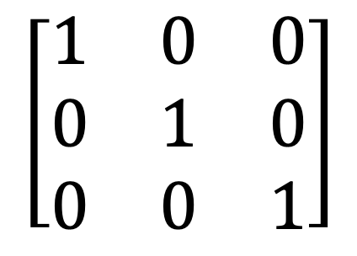
More data structures and data types
R has more data structures
Lists
Matrices & Arrays
Data frames
Data types
complex
1 + 4i
raw
Custom types e.g. Interval
$$\left[\begin{matrix}1 & 0 & 0 \\ 0 & 1 & 0 \\ 0 & 0 & 1\end{matrix}\right]$$

Slide 35
Factors and type conversions
Demo

Slide 36
Missing data
Data is very rarely complete
In R missing data is represented by a special symbol NA
weights_kg <- c(70, NA, 115)
R is cautious in its treatment of missing values, requiring the user to explicitly state how missing data should be treated

Slide 37
Missing data
Missing values will propagate through calculations
> weights_kg <- c(70, NA, 115)
> mean(weights_kg)
[1] NA
> mean(weights_kg, na.rm=TRUE)
[1] 92.5
> is.na(weights_kg)
[1] FALSE TRUE FALSE

Slide 38
Missing data
Demo

Slide 39
End of Part 1

Slide 40
End of Part 1
Break
Review material so far
Questions??

Slide 41
Rectangular data
Vectors contain a single dimension of a single data type
It is more useful to collect data into a rectangular or tabular form
This is called a data frame
A data frame is a rectangular collection of variables (in the columns) and observations (in the rows)

Slide 42
Rectangular data
Each column of a data frame has a single data type and a name
Can be conceptualised as a list of named vectors all the same length
study_id | sex | age | weight_kg
id_01 | M | 28 | 70
id_02 | F | 46 | 80
id_03 | F | 21 | 120
id_04 | M | 65 | 75

Slide 43
Rectangular data
R has a special object type for this kind of data: data.frame
Can create data frames by supplying vectors of data as arguments to the data.frame() function call
Rather confusingly the tidyverse has a slightly different version of tabular data named a tibble()
data.frame and tibble are essentially the same

Slide 44
Rectangular data – useful functions
To get the number of rows in a data.frame
nrow(my_data_frame)
To get the column names of a data.frame
names(my_data_frame)

Slide 45
Rectangular data – useful functions
Summarise a data frame
summary(my_data_frame)
Slightly shorter version
str(my_data_frame)
tidyverse version
dplyr::glimpse(my_data_frame)

Slide 46
data.frame
Demo

Slide 47
Indexing data.frame
Similar to indexing vectors but now in two dimensions
Use square brackets with two indices
First index is row number
Second is column number
my_data_frame[row_number, column_number]
Get entire row or column by just specifying row or column indices
my_data_frame[row_number,]
my_data_frame[,column_number]

Slide 48
Indexing data.frame
Similar to indexing vectors but now in two dimensions
Use square brackets with two indices
First index is row number
Second is column number
my_data_frame[row_number, column_number]
Get entire rows or columns by specifying only row or column indices
my_data_frame[row_number,]
my_data_frame[,column_number]

Slide 49
Indexing data.frame
Also get a single entire column by using $ notation
my_data_frame$age
These indexing techniques are base R
Equivalent functionality from tidyverse functions

Slide 50
Indexing data.frame
Can specify column names in the square brackets
my_data_frame[, “sex”]
Logical indexing of rows and columns
Can provide vectors of logical values to index a data frame
my_data_frame[c(TRUE, FALSE, TRUE, FALSE),]

Slide 51
Indexing data.frame
Indexing data frames is very powerful
Described as is commonly used and quick
Syntax is a little hard to read and can be confusing
tidyverse functions provide similar functionality

Slide 52
Indexing data.frame
Demo

Slide 53
Tidy data
Important to have consistently organised data
Concept of tidy data
Tidy data paper by Hadley Wickham
(R for data science chapter)
Tidy data is easy to transform and manipulate

Slide 54
Tidy data
There are three inter-related rules which make a dataset tidy:
Each variable must have its own column
Each observation must have its own row
Each value must have its own cell
Cannot satisfy only two of these rules – inter-related

Slide 55
Tidy data
icu | year | ards_cases | total_admissions
Medical | 1999 | 100 | 2500
Medical | 2000 | 200 | 2700
Surgical | 1999 | 10 | 1000
Surgical | 2000 | 15 | 1200
ECMO | 1999 | 120 | 130
ECMO | 2000 | 100 | 150

Slide 56
Not Tidy data
icu | year | type | value
Medical | 1999 | cases | 100
Medical | 2000 | cases | 200
Medical | 1999 | admissions | 2500
Medical | 2000 | admissions | 2700
Surgical | 1999 | cases | 10
Surgical | 2000 | cases | 15
Surgical | 1999 | admissions | 1000
Surgical | 2000 | admissions | 1200
ECMO | 1999 | cases | 120
ECMO | 2000 | cases | 100
ECMO | 1999 | admissions | 130
ECMO | 2000 | admissions | 150

Slide 57
Not Tidy data
icu | year | rate
Medical | 1999 | 100 / 2500
Medical | 2000 | 200 / 2700
Surgical | 1999 | 10 / 1000
Surgical | 2000 | 15 / 1200
ECMO | 1999 | 120 / 130
ECMO | 2000 | 100 / 150

Slide 58
Tidy data
Consistent data structure means the same tools can be used against data
Each column is a vector, so can use vectorised functions
Tidy data is easy to manipulate and analyse
Tidy data fits with tidyverse packages
Most regression and plotting functions can use tidy data directly
Tidy data fits with tidyverse packages

Slide 59
Tidy data
Tidy data fits with tidyverse packages
tidyr package provides tools to make data tidy

Slide 60
Mini break!

Slide 61

Data manipulation
dplyr is package for manipulation of tabular data
It provides a grammar of data manipulation, with a consistent set of verbs that help you to perform data manipulation
https://dplyr.tidyverse.org/
dplyr cheat sheet
https://r4ds.hadley.nz/data-transform

Slide 62
Data manipulation
Verbs that manipulate data are implemented as functions
Pattern of calling tidyverse functions where:
data frame is the first argument to the function
named arguments can modify the behaviour of the function
function returns modified data frame

Slide 63
Data manipulation
my_data_frame
study_id | sex | age | weight_kg
id_01 | M | 28 | 70
id_02 | F | 46 | 80
id_03 | F | 21 | 120
id_04 | M | 65 | 75

Slide 64
Data manipulation
Operate on rows
arrange() changes the ordering of the rows
filter() picks cases based on their values
distinct() keep rows which are unique

Slide 65
Data manipulation
arrange() changes the ordering of the rows of a data frame by the values of selected columns
arrange(my_data_frame, age)
study_id | sex | age | weight_kg
id_03 | F | 21 | 120
id_01 | M | 28 | 70
id_02 | F | 46 | 80
id_04 | M | 65 | 75

Slide 66
Data manipulation
filter() picks cases based on their values
filter(my_data_frame, sex == “M”)
study_id | sex | age | weight_kg
id_01 | M | 28 | 70
id_04 | M | 65 | 75

Slide 67
Data manipulation
distinct() keep rows which are unique
distinct(my_data_frame)
study_id | sex | age | weight_kgs
id_03 | F | 21 | 120
id_01 | M | 28 | 70
id_02 | F | 46 | 80
id_04 | M | 65 | 75

Slide 68
Data manipulation
distinct() keep rows which are unique
distinct(my_data_frame, sex, .keep_all = TRUE)
sex
F
M

Slide 69
Data manipulation
distinct() keep rows which are unique
distinct(my_data_frame, sex, .keep_all = TRUE)
study_id | sex | age | weight_kgs
id_01 | M | 28 | 70
id_02 | F | 46 | 80

Slide 70
Data manipulation - rows
Demo

Slide 71
Data manipulation
Operate on columns
select() picks variables based on their names
rename() rename variables
mutate() adds new variables that are functions of existing variables
summarise() reduces multiple values down to a single summary

Slide 72
Data manipulation
select() picks variables based on their names
Comma separated list of column names
Or a vector of column names
select(my_data_frame, study_id, age)
study_id | age
id_03 | 21
id_01 | 28
id_02 | 46
id_04 | 65

Slide 73
Data manipulation
select() picks variables based on their names
Can also remove columns with a minus sign prefix
select(my_data_frame, -study_id)
sex | age | weight_kg
F | 21 | 120
M | 28 | 70
F | 46 | 80
M | 65 | 75

Slide 74
Data manipulation
rename() rename variables
Note order of new_name = old_name
rename(my_data_frame, age_years = age)
study_id | sex | age_years | weight_kg
id_01 | M | 28 | 70
id_02 | F | 46 | 80
id_03 | F | 21 | 120
id_04 | M | 65 | 75

Slide 75
Data manipulation
mutate() adds new variables that are functions of existing variables
mutate(my_data_frame, weight_lb = weight_kg * 2.2)
study_id | sex | age | weight_kg | weight_lb
id_01 | M | 28 | 70 | 154
id_02 | F | 46 | 80 | 176
id_03 | F | 21 | 120 | 264
id_04 | M | 65 | 75 | 165

Slide 76
Data manipulation
if_else() allows conditional mutation of data
mutate(
my_data_frame,
weight_kgs = if_else(
sex == "M", # condition
weight_kg + 10, # if TRUE use this
weight_kg # if FALSE use this
)
)

Slide 77
Data manipulation
if_else() allows conditional mutation of data
study_id | sex | age | weight_kgs
id_03 | F | 21 | 120
id_01 | M | 28 | 80
id_02 | F | 46 | 80
id_04 | M | 65 | 85

Slide 78
Data manipulation
dplyr is an essential package
There are many more functions in dplyr
Dplyr cheat sheet is essential reading

Slide 79
Data manipulation
dplyr does not only work on data frames!
The same grammar and verbs can be used against databases or other implementations of rectangular data

Slide 80
Data manipulation - columns
Demo

Slide 81
The pipe |>
A common pattern is to apply a sequence of functions to some data, creating intermediate data frames
my_new_dataframe <- mutate(my_data_frame, weight_lb = weight_kg * 2.2)
my_new_new_dataframe <- filter(my_new_dataframe, sex == “M”)

Slide 82
The pipe |>
This is costly in terms of memory and names
If the data frames are large and the temporary data frames are only used once
Hard to read
Could nest the functions:
my_new_dataframe <- filter(mutate(my_data_frame, weight_lb = weight_kg * 2.2), sex == “M”)
This is even harder to read!
This is just two nested functions, we often will have many more

Slide 83
The pipe |>
Use the pipe operator to pass the results of one function to the next
|>
|> is part of base R
Older version is %>%
Imported by the tidyverse set of packages
Use |> or %>%
RStudio keyboard short cut Ctrl-Shift M

Slide 84
The pipe |>
my_new_dataframe <- mutate(my_data_frame, weight_lb = weight_kg * 2.2)
my_new_new_dataframe <- filter(my_new_dataframe, sex == “M”)
Becomes
my_new_dataframe <- my_data_frame |>
mutate(weight_lb = weight_kg * 2.2) |>
filter(sex == “M”)

Slide 85
The pipe |>
Use the pipe operator to pass data, or the results of a function, in to another function
my_data_frame |>
filter(sex==“M”)

Slide 86
The pipe |>
LHS |> RHS
The function on the left-hand side (LHS) of a pipe returns an object.
The pipe sends that object, to the first argument of the function on the right-hand side (RHS)
tidyverse functions all expect data as the first argument, so they are compatible with the pipe
Syntactic sugar!

Slide 87
The pipe |>
Demo

Slide 88
Resources
R for Data Science
tidyverse.org
Tidy data

